Slide 1

DIGITAL ELECTRONICS
III Semester CSE
Dr. Ranjita Rout
DEPARTMENT OF ELECTRONICS AND COMMUNICATION ENGINEERING
SCHOOL OF ENGINEERING & TECHNOLOGY
GIET UNIVERSITY, GUNUPUR, ODISHA

Slide 2
Counters
Asynchronous Counters;
Design of Asynchronous Counters;
Synchronous Counters;
Design of Synchronous Counters;
Ring Counter

Slide 3
Counters
A counter is essentially a register that goes through a predetermined sequence of binary states. The gates in the counter are connected in such a way as to produce the prescribed sequence of states.
A register that goes through a prescribed sequence of states according to the application of input pulses is called a counter.
The input pulses may be clock pulses, or they may originate from some external source and may occur at a fixed interval of time or at random.

Slide 4
The sequence of states may follow the binary number sequence or any other sequence of states.
A counter that follows the binary number sequence is called a binary counter.
An n‐bit binary counter consists of n flip‐flops and can count in binary from 0 through 2^{n} - 1.

Slide 5
Counters are available in two categories: ripple / asynchronous counters and synchronous counters.
In a ripple counter, a flip‐flop output transition serves as a source for triggering other flip‐flops.
In other words, the Clock (C) input of some or all flip‐flops are triggered, not by the common clock pulses, but rather by the transition that occurs in other flip‐flop outputs.
In a synchronous counter, the C inputs of all flip‐flops receive the common clock.

Slide 6
Comparison of Synchronous and Asynchronous Counters
Synchronous Counter
Asynchronous Counter
In synchronous counter, the common clock input is connected to all the flip-flops and thus they are clocked simultaneously.
Design and implementation becomes tedious and complex as the number of states increases.
In asynchronous counter, each flip-flop is triggered by the previous flip-flop and the counter has a commutative setting time. Hence, the flip-flops are not clocked simultaneously.
Design and implementation is very simple even for more number of states.

Slide 7
A counter may be an up-counter or a down-counter.
An up-counter is a counter which counts in the upward direction, i.e. 0, 1, 2, 3, …, N.
A down-counter is a counter which counts in the downward direction, i.e. N, N - 1, N - 2, N - 3, …, 1, 0.
Each of the counts of the counter is called the state of the counter.
The number of states through which the counter passes before returning to the starting state is called the modulus of the counter.

Slide 8
Since a 2-bit counter and has 2² = 4 states, it is called a mod-4 counter. It divides the input clock signal frequency by 4, therefore, it is also called a divide-by-4 counter. It requires 2 FFs.
Similarly, a 3-bit counter uses 3 FFs and has 2³ = 8 states. It divides the input clock frequency by 8. It is also called a divide-by-8 counter. It requires 3 FFs.
In general, an n-bit counter will have n FFs and 2^{n} states, and divides the input frequency by 2^{n}. Hence, it is a divide-by-2^{n} counter.

Slide 9
A counter which goes through all the possible states before restarting is called the full modulus counter.
A counter in which maximum number of states can be changed is called the variable modulus counter.
The final state of the counter sequence is called the terminal count.

Slide 10
Asynchronous Counters
Asynchronous Counters are also called ripple counters.
The ripple counter is the simplest type of counter, the easiest to design and requires the least amount of hardware.
A binary ripple counter consists of a series connection of complementing flip‐flops, with the output of each flip‐flop connected to the C input of the next higher order flip‐flop.

Slide 11
The flip‐flop holding the least significant bit receives the incoming count pulses or clock pulses.
A complementing flip‐flop can be obtained from a JK flip‐flop with the J and K inputs tied together or from a T flip‐flop. The inputs of JK flip‐flop and T flip‐flop are connected to a permanent logic 1.
A third possibility is to use a D flip‐flop with the complement output connected to the D input. In this way, the D input is always the complement of the present state, and the next clock pulse will cause the flip‐flop to complement.

Slide 12
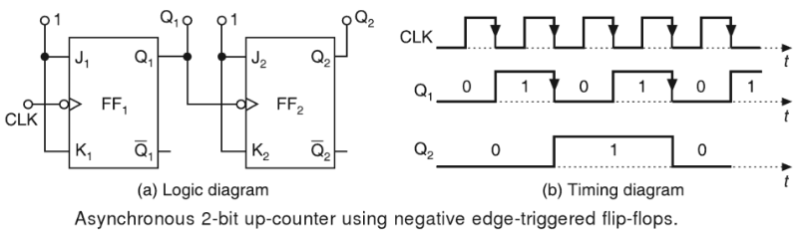
2-bit Ripple Up-counter using Negative Edge-triggered Flip-Flops
The 2-bit up-counter counts in the order 0, 1, 2, 3, 0, 1, …, i.e. 00, 01, 10, 11, 00, 01, …, etc.
Figure shows a 2-bit ripple up-counter, using negative edge-triggered J-K FFs, and its timing diagram.

Slide 13
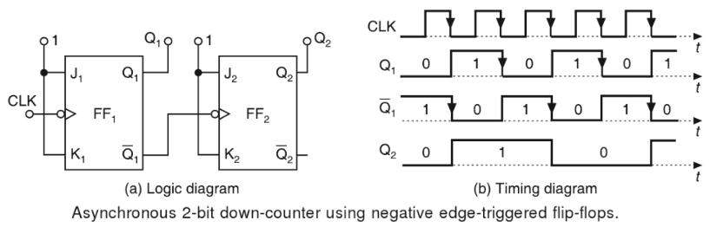
2-bit Ripple Down-counter using Negative Edge-triggered Flip-Flops
The 2-bit down-counter counts in the order 0, 3, 2, 1, 0, 3, …, i.e. 00, 11, 10, 01, 00, 11, …, etc.
Figure shows a 2-bit ripple down-counter, using negative edge-triggered J-K FFs, and its timing diagram.

Slide 14
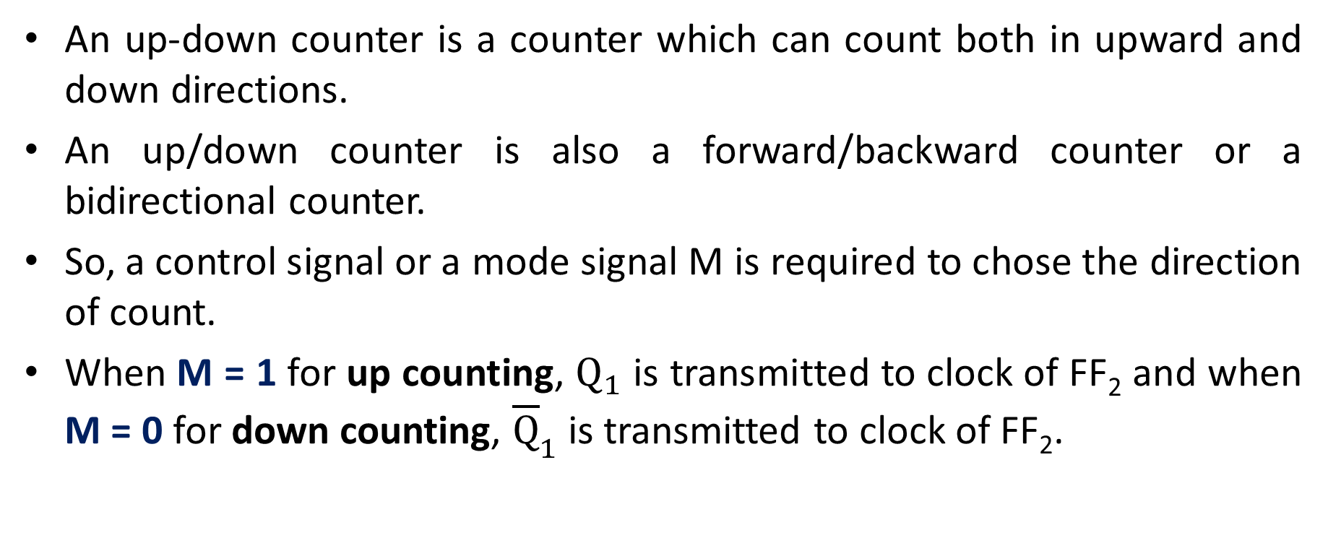
2-bit Ripple Up-down Counter using Negative Edge-triggered Flip-Flops
An up-down counter is a counter which can count both in upward and down directions.
An up/down counter is also a forward/backward counter or a bidirectional counter.
So, a control signal or a mode signal M is required to chose the direction of count.
When M = 1 for up counting, $Q_{1}$ is transmitted to clock of FF₂ and when M = 0 for down counting, ${\overline{Q}}_{1}$ is transmitted to clock of FF₂.

Slide 15
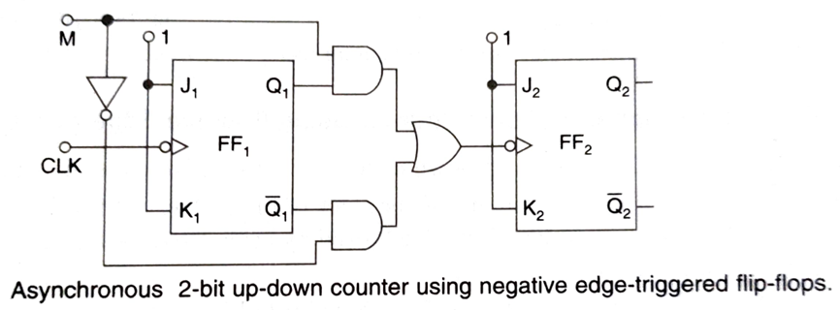
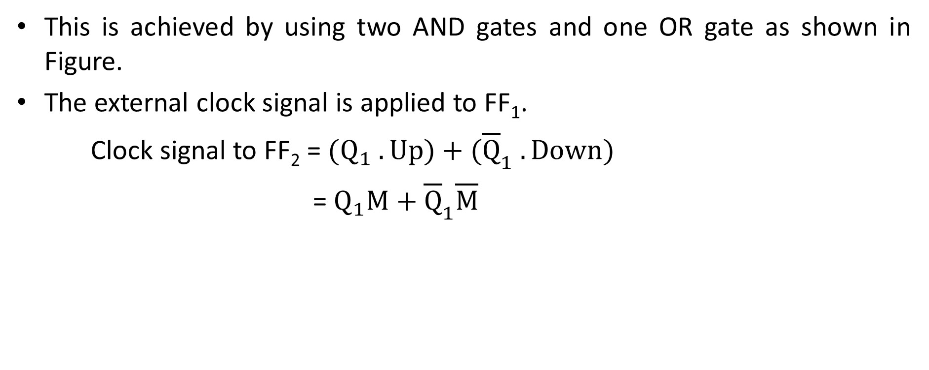
This is achieved by using two AND gates and one OR gate as shown in Figure.
The external clock signal is applied to FF₁.
Clock signal to FF₂ = ${(Q}_{1} . Up)+({\overline{Q}}_{1} . Down)$
= $Q_{1}M+{\overline{Q}}_{1}\overline{M}$

Slide 16
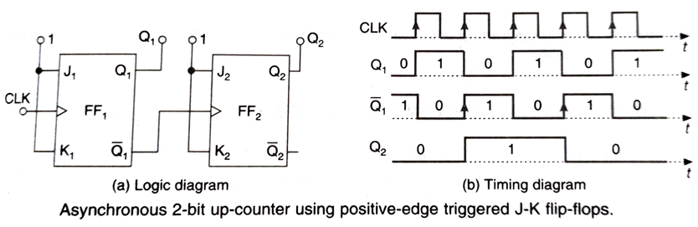
2-bit Ripple Up-counter using Positive Edge-triggered Flip-Flops
A 2-bit ripple up-counter, using positive edge-triggered J-K FFs, and its timing diagram are shown in Figure.
The counting sequence is 00, 01, 10, 11, 00, 01, …, etc.

Slide 17
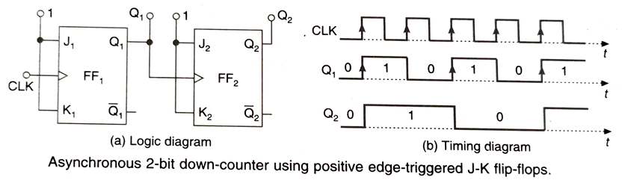
2-bit Ripple Down-counter using Positive Edge-triggered Flip-Flops
A 2-bit ripple down-counter, using positive edge-triggered J-K FFs, and its timing diagram are shown in Figure.
The counting sequence is 0,3,2,1,0,3,2,-----etc. i.e. 00, 11, 10, 01, 00,….etc.

Slide 18
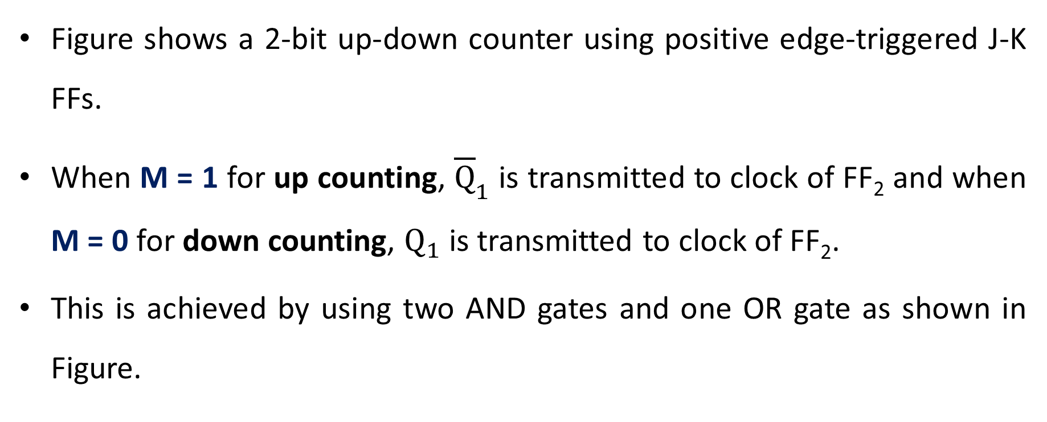
2-bit Ripple Up-down Counter using Positive Edge-triggered Flip-Flops
Figure shows a 2-bit up-down counter using positive edge-triggered J-K FFs.
When M = 1 for up counting, ${\overline{Q}}_{1}$ is transmitted to clock of FF₂ and when M = 0 for down counting, $Q_{1}$ is transmitted to clock of FF₂.
This is achieved by using two AND gates and one OR gate as shown in Figure.

Slide 19
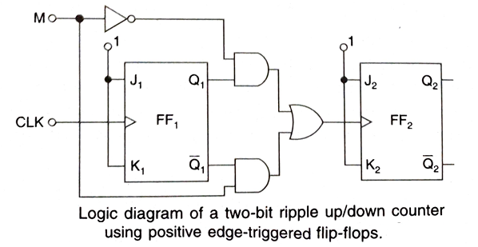

Clock signal to FF₂ = ${({\overline{Q}}_{1} . Up)\text{ + }(Q}_{1} . Down)$
= ${\overline{Q}}_{1}M+Q_{1}\overline{M}$

Slide 20
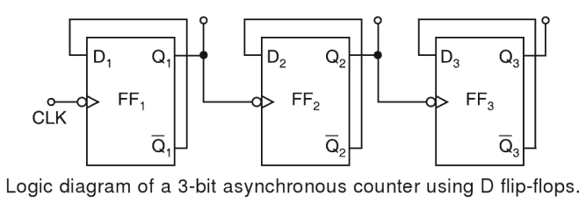
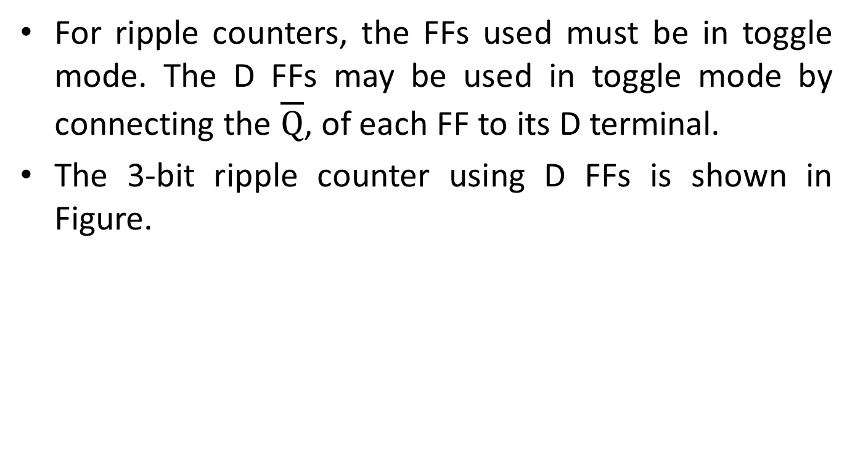
3-bit Ripple Counter using D FFs
For ripple counters, the FFs used must be in toggle mode. The D FFs may be used in toggle mode by connecting the $\overline{Q}$, of each FF to its D terminal.
The 3-bit ripple counter using D FFs is shown in Figure.

Slide 21
4‐bit Binary Ripple Counters
The logic diagram of two 4‐bit binary ripple counters is shown in Figure.
The counter is constructed with complementing flip‐flops of the T type in part (a) and D type in part (b).
The output of each flip‐flop is connected to the C input of the next flip‐flop in sequence.
The flip‐flop holding the least significant bit receives the incoming count pulses.

Slide 22
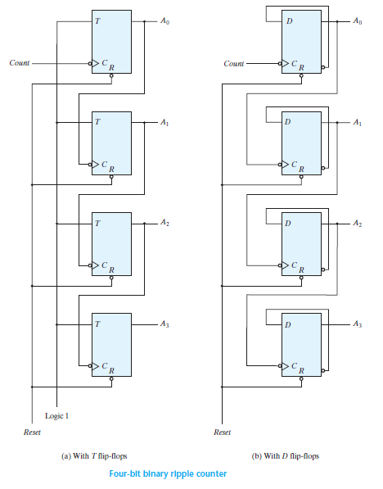

Slide 23
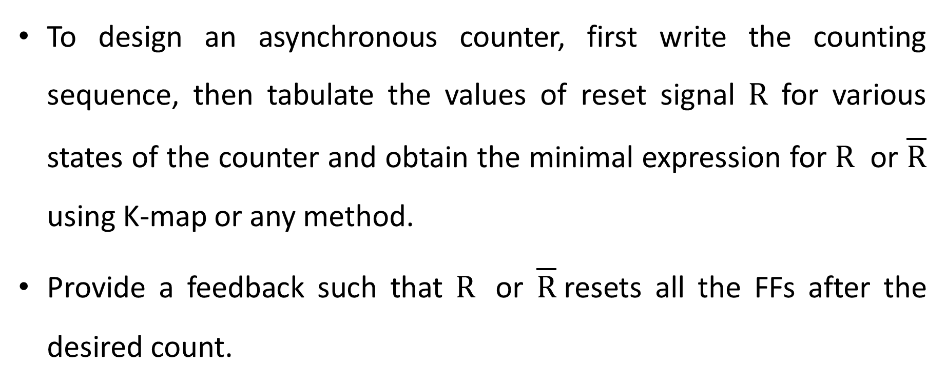
Design of Asynchronous Counters
To design an asynchronous counter, first write the counting sequence, then tabulate the values of reset signal $R$ for various states of the counter and obtain the minimal expression for $R$ or $\overline{R}$ using K-map or any method.
Provide a feedback such that $R$ or $\overline{R}$resets all the FFs after the desired count.

Slide 24
Design of a Mod-6 Asynchronous Counter using T FFs.
A mod-6 counter has six stable states 000, 001, 010, 011, 100, and 101.
It is a ‘divide-by-6 counter’, in the sense that it divides the input clock frequency by 6.
It requires three FFs, because the smallest value of n satisfying the condition N ≤ 2^{n} is n = 3; three FFs can have eight possible states out of which only six are utilized and the remaining two states 110 and 111, are invalid.

Slide 25
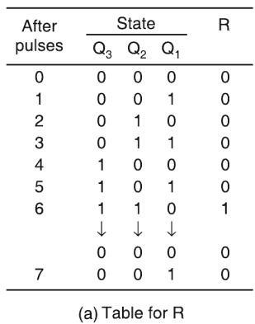
For the design, write a truth table with the present state Q₃, Q₂, and Q₁ as the variables and reset R as the output and obtain an expression for R in terms of Q₃, Q₂, and Q₁.

Slide 26
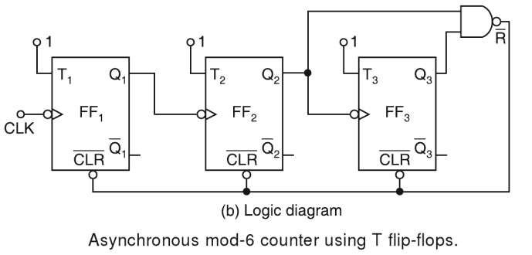

The expression for R can also be determined as follows.
R = 0 for 000 to 101, R = 1 for 110, and R = X for 111
Therefore, $R=Q_{3}Q_{2}{\overline{Q}}_{1}+Q_{3}Q_{2}Q_{1}=Q_{3}Q_{2}$

Slide 27
Design of a Mod-10 Asynchronous Counter using T FFs.
A mod-10 counter is a decade counter. It is also called a BCD counter or a divide-by-10 counter.
It requires four FFs (the smallest value of n satisfying the condition 10 ≤ 2^{n}, is n = 4). So, there are 16 possible states, out of which ten are valid and the remaining six are invalid.
The counter has ten stable states, 0000 through 1001, i.e. it counts from 0 to 9.

Slide 28
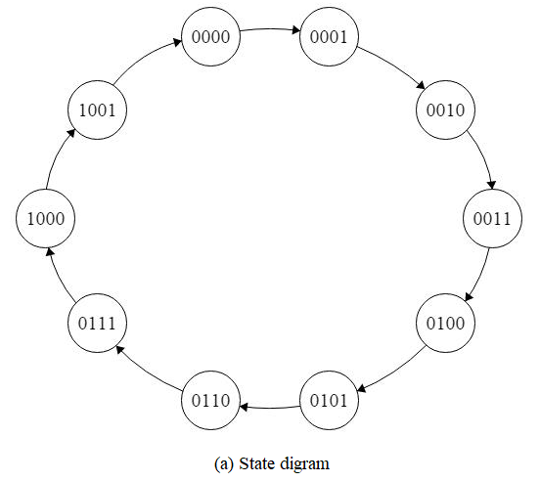
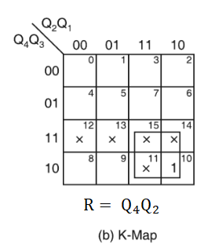
The state 1010 is a temporary state for which the reset signal R = 1, R = 0 for 0000 to 1001, and R = X (don’t care) for 1011 to 1111.

Slide 29
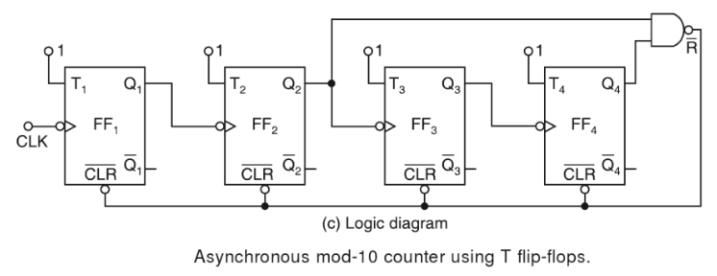

Slide 30
Synchronous Counters
Synchronous counters are different from ripple counters in that clock pulses are applied to the inputs of all flip‐flops.
A common clock triggers all flip‐flops simultaneously, rather than one at a time in succession as in a ripple counter.

Slide 31
Design of Synchronous Counters
For a systematic design of synchronous counters, the following procedure is used.
Step 1. Number of flip-flops: Based on the description of the problem, determine the required number n of the FFs – the smallest value of n is such that the number of states N ≤ 2^{n} – and the desired counting sequence.
Step 2. State diagram: Draw the state diagram showing all the possible states.

Slide 32
Step 3. Choice of flip-flops and excitation table: Select the type of flip-flops to be used and write the excitation table that lists the present state (PS), the next state (NS) and the required excitation.
Step 4. Minimal expressions for the excitations: Obtain the minimal expressions for the excitations of the FFs using K-maps drawn for the excitations of the flip-flops in terms of present state and inputs.
Step 5. Logic diagram: Draw a logic diagram based on the minimal expressions.

Slide 33
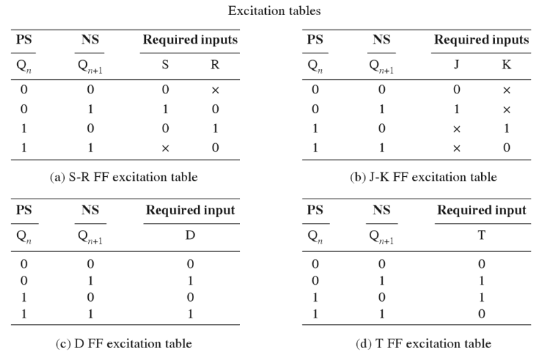

Slide 34
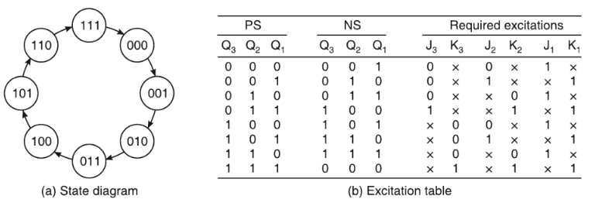
Design of a Synchronous 3-bit Up Counter using J-K FFs.

Slide 35
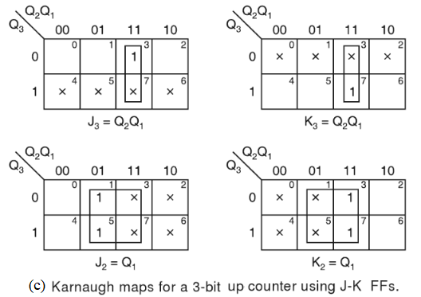
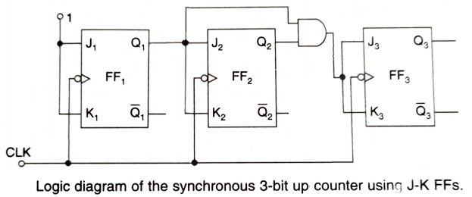

Slide 36
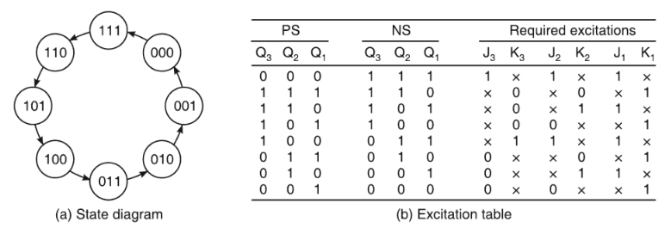
Design of a Synchronous 3-bit Down Counter using J-K FFs.

Slide 37
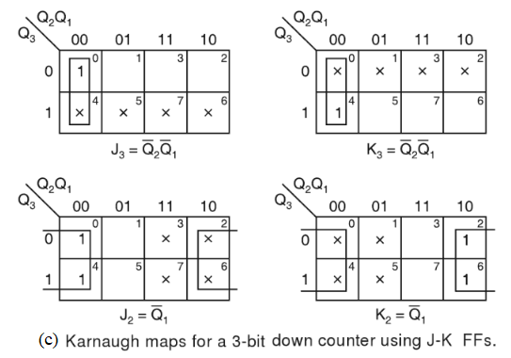
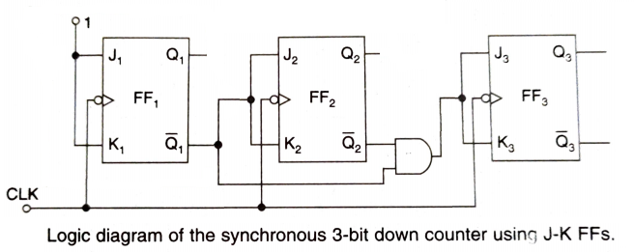

Slide 38
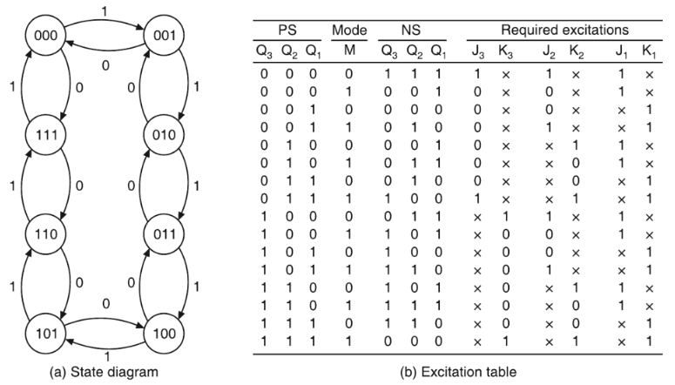
Design of a Synchronous 3-bit Up-down Counter using J-K FFs.

Slide 39
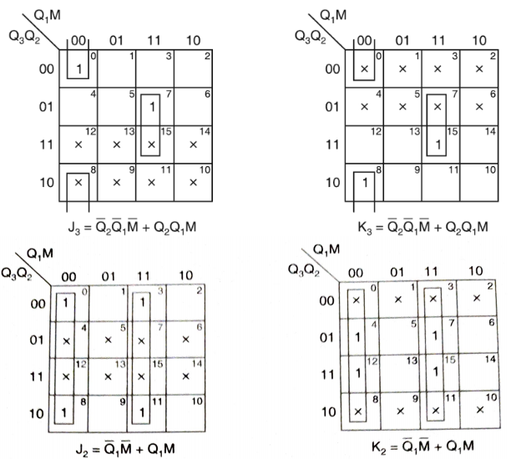

Slide 40
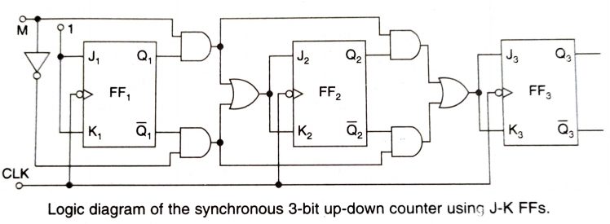

Slide 41
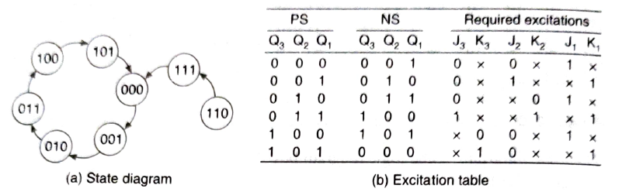
Design of a Synchronous Mod-6 Counter using J-K FFs.

Slide 42
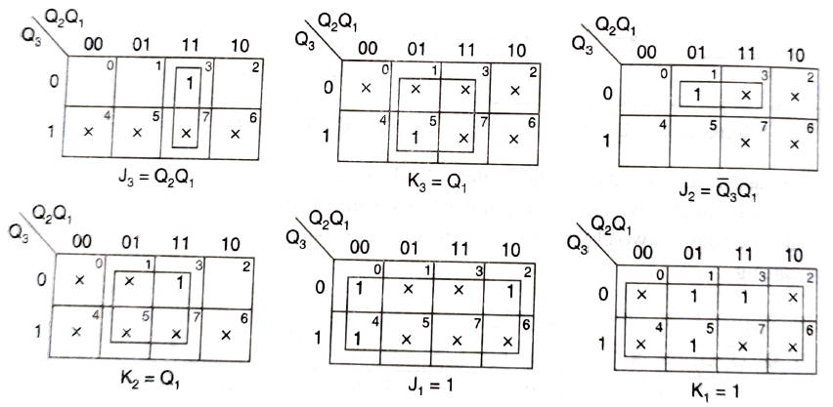

Slide 43
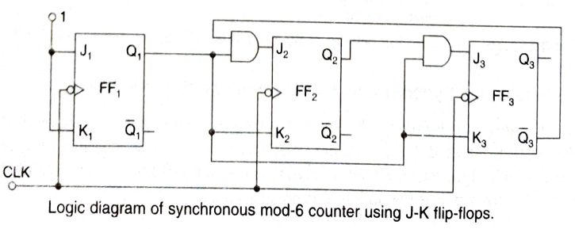

Slide 44
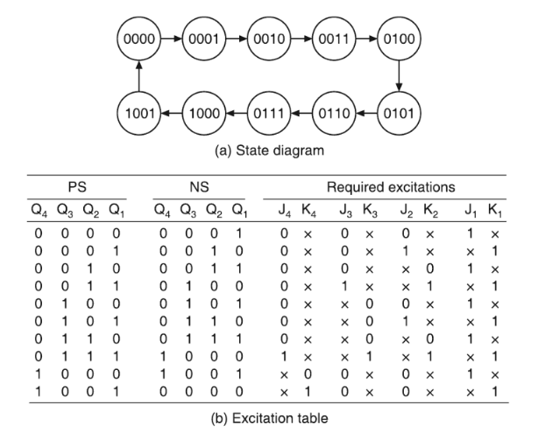
Design of a Synchronous BCD Counter using J-K FFs.

Slide 45
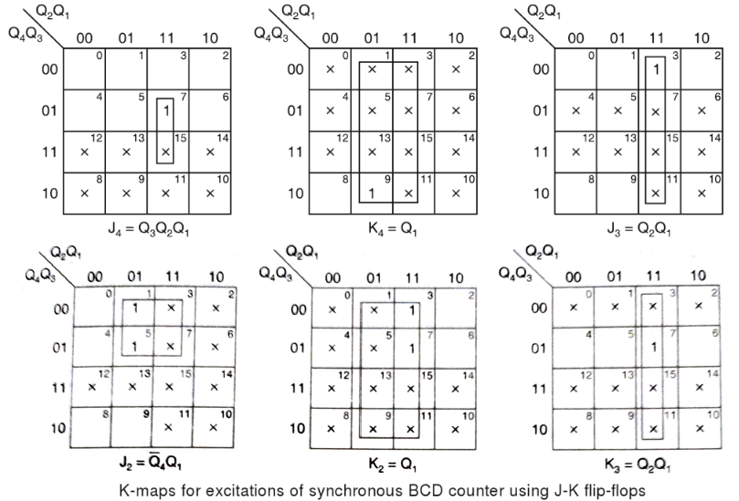

Slide 46
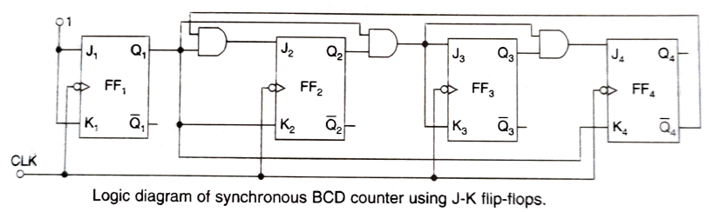

Slide 47
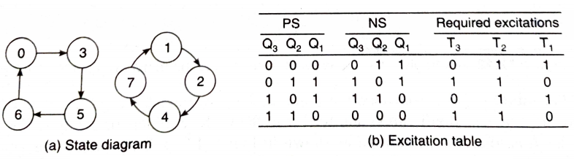
Example: Design a type T counter that goes through states 0, 3, 5, 6, 0… .

Slide 48
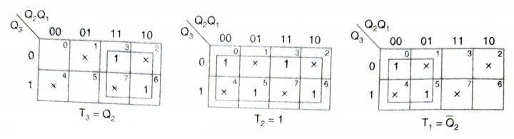
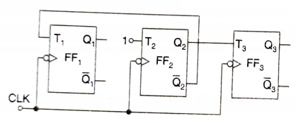

Slide 49
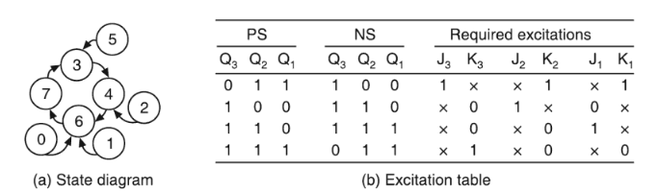
Example: Design a J-K counter that goes through states 3, 4, 6, 7 and 3… .

Slide 50
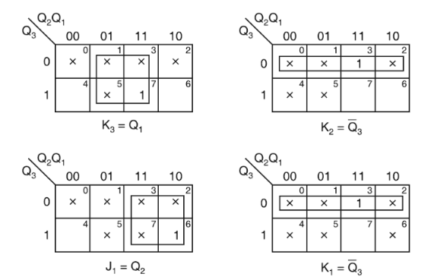
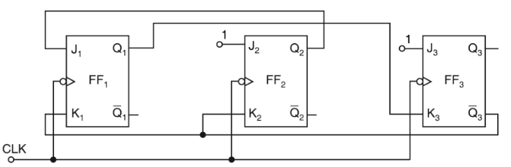

Slide 51
Shift Register Counters
Shift register counters are obtained from serial-in, serial-out shift registers by providing feedback from the output of the last FF to the input of the first FF.
These devices are called counters because they exhibit a specified sequence of states.
The most widely used shift register counter is the ring counter as well as the switch-tail ring counter or Johnson counter.

Slide 52
Ring Counter
A ring counter is a circular shift register with only one flip‐flop being set at any particular time; all others are cleared.
The single bit is shifted from one flip‐flop to the next to produce the sequence of timing signals.
The FFs are arranged as in a normal shift register, i.e. the Q output of each stage is connected to the D input of the next stage, but the Q output of the last FF is connected back to the D input of the first FF.

Slide 53
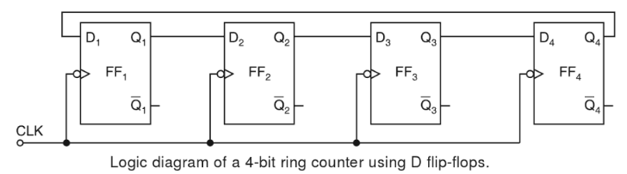
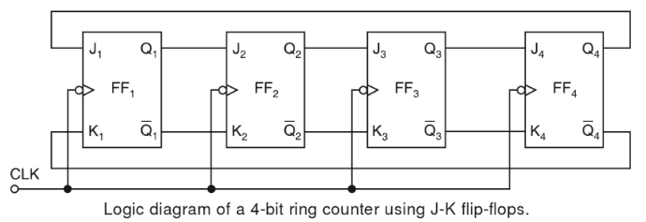

Slide 54
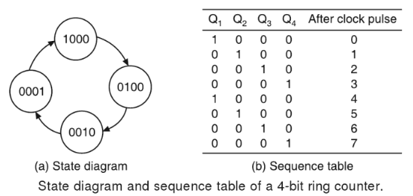
The number of distinct states in the ring counter , i.e. the mod of the ring counter is equal to the number of FFs used in the counter.
An n-bit ring counter can count only n bits, whereas an n-bit ripple counter can count 2^{n} bits.

Slide 55
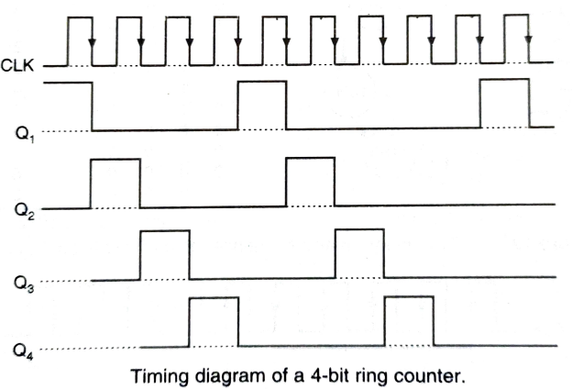

Slide 56
Johnson Counter
A k ‐bit ring counter circulates a single bit among the flip‐flops to provide k distinguishable states.
The number of states can be doubled if the shift register is connected as a switch‐tail ring counter / Johnson counter.
A switch‐tail ring counter is a circular shift register with the complemented output of the last flip‐flop connected to the input of the first flip‐flop.

Slide 57
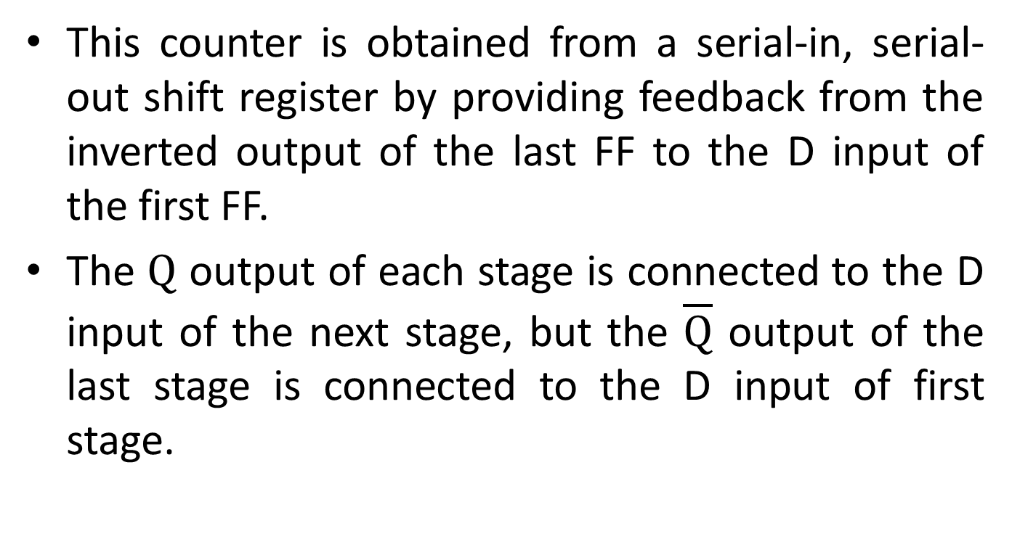
This counter is obtained from a serial-in, serial-out shift register by providing feedback from the inverted output of the last FF to the D input of the first FF.
The $Q$ output of each stage is connected to the D input of the next stage, but the $\overline{Q}$ output of the last stage is connected to the D input of first stage.

Slide 58
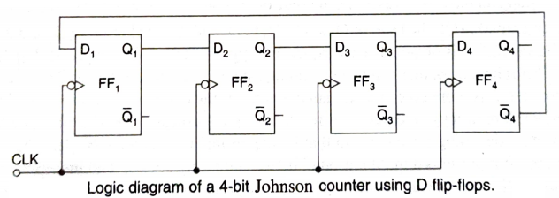
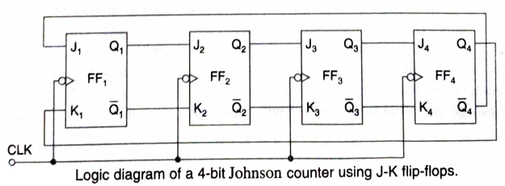

Slide 59
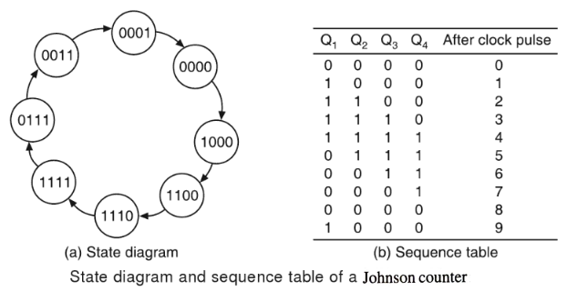
An n FF Johnson counter can have 2n unique states and can count up to 2n pulses. So it is a mod-2n counter.

Slide 60


